Slide 1

Decision Trees – Math
Presented by:
Elizer Ponio Jr.
Department of Computer Science
College of Computing and Information Technologies

Slide 2
Outline
Introduction
Decision Tree Example
Building a Decision Tree

Slide 3
I want have six pack abs
True
False
Go to the gym
Drink alcoholic drinks everyday

Slide 4
In general, decision trees make a statement
I want have six pack abs
And then makes a decision whether or not the statement is True or False
True
False
Go to the gym
Drink alcoholic drinks everyday

Slide 5
When a decision tree classifies things into categories,
I want have six pack abs
its called a classification tree
True
False
Go to the gym
Drink alcoholic drinks everyday

Slide 6
And when a decision tree predicts numerical values
I have an expensive phone
Its called a regression tree
True
False
It is between 20 to 100 thousand pesos
It is less than 20 thousand pesos

Slide 7

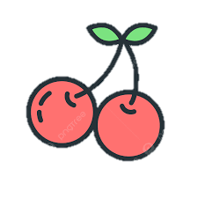

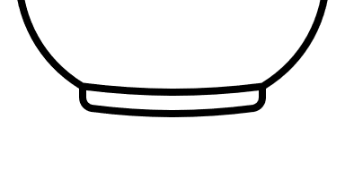
For the most part, classification trees are easy to work with
Is the color of the fruit red?
True
False
Is the shape of the fruit round/circle?
True
False

Slide 8
You start at the top
Is the color of the fruit red?
True
False
Is the shape of the fruit round/circle?
True
False

Slide 9
You start at the top
Is the color of the fruit red?
True
False
Is the shape of the fruit round/circle?
And work you way down
True
False

Slide 10
You start at the top
Is the color of the fruit red?
True
False
Is the shape of the fruit round/circle?
And work you way down
True
False
Until you get to a point where you cannot go any further and that is how we classify something!

Slide 11
Fruits Example
Is color red? | Is Round? | Diameter | Label
Yes | Yes | 1 | Cherry
Yes | Yes | 1 | Cherry
Yes | Yes | 1 | Cherry
Yes | Yes | 1 | Cherry
Yes | No | 5 | Apple
No | Yes | 6 | Orange
No | Yes | 7 | Orange
Yes | No | 7 | Apple
Yes | No | 8 | Apple
Yes | No | 9 | Apple

Slide 12
The first thing we do is decide is whether asking if the fruit color is red or is the shape round or its diameter should be the question we ask at the very top of the tree
????
True
False

Slide 13
To make that decision, we will start looking at how well asking if the color of the fruit is red
????
True
False

Slide 14
To do this, we will make a simple tree that only asks if the fruit color is red.
Is the color of the fruit red?
True
False

Slide 15
And then we run down the data to the tree
Is color red? | Is Round? | Diameter | Label
Yes | Yes | 1 | Cherry
Yes | Yes | 1 | Cherry
Yes | Yes | 1 | Cherry
Yes | Yes | 1 | Cherry
Yes | No | 5 | Apple
No | Yes | 6 | Orange
No | Yes | 7 | Orange
Yes | No | 7 | Apple
Yes | No | 8 | Apple
Yes | No | 9 | Apple
Is the color of the fruit red?
True
False

Slide 16
And then we run down the data to the tree
Is color red? | Is Round? | Diameter | Label
Yes | Yes | 1 | Cherry
Yes | Yes | 1 | Cherry
Yes | Yes | 1 | Cherry
Yes | Yes | 1 | Cherry
Yes | No | 5 | Apple
No | Yes | 6 | Orange
No | Yes | 7 | Orange
Yes | No | 7 | Apple
Yes | No | 8 | Apple
Yes | No | 9 | Apple
Is the color of the fruit red?
True
False

Slide 17
Let us do the exact same thing for the question “Is Round?”
Is color red? | Is Round? | Diameter | Label
Yes | Yes | 1 | Cherry
Yes | Yes | 1 | Cherry
Yes | Yes | 1 | Cherry
Yes | Yes | 1 | Cherry
Yes | No | 5 | Apple
No | Yes | 6 | Orange
No | Yes | 7 | Orange
Yes | No | 7 | Apple
Yes | No | 8 | Apple
Yes | No | 9 | Apple
Is Round?
True
False

Slide 18
Looking at our two simple trees, we see that neither one does a perfect job of predicting the label of the fruit.
Is the color of the fruit red?
Is Round?
True
False
True
False

Slide 19
Is the color of the fruit red?
Is Round?
True
False
True
False
Looking at our two simple trees, we see that neither one does a perfect job of predicting the label of the fruit.

Slide 20
Is the color of the fruit red?
Is Round?
True
False
True
False
Specifically, these two leaf nodes contain mixtures of fruits that have the different labels

Slide 21
Is the color of the fruit red?
Is Round?
True
False
True
False
Because these leaf nodes all contain a mixture of fruits with different labels, they are called Impure

Slide 22
Is the color of the fruit red?
Is Round?
True
False
True
False
And because both of our trees have a leaf node that is impure, how do we know which one do we ask first?

Slide 23
Is the color of the fruit red?
Is Round?
True
False
True
False
One of the most popular methods is called Gini Impurity, but there are also other methods like Entropy and Information Gain

Slide 24

Is the color of the fruit red?
Is Round?
True
False
True
False
Let us start by calculating the Gini Impurity of “Is the color of the fruit red?”

Slide 25


Is the color of the fruit red?
True
False
To calculate the Gini Impurity for “Is the color of the fruit red?”, we start by calculating the Gini Impurity for the individual leaves

Slide 26


Is the color of the fruit red?
True
False
$$Gini impurity of leaf= 1 −{\left(the probability of apple\right)}^{2}−{\left(the probability of orange \right)}^{2}{−\left(the probability of cherry \right)}^{2}$$

Slide 27
Is the color of the fruit red?
True
False
$$Gini impurity of leaf= 1 −{\left(the probability of apple\right)}^{2}−{\left(the probability of orange \right)}^{2}{−\left(the probability of cherry \right)}^{2}$$

Slide 28

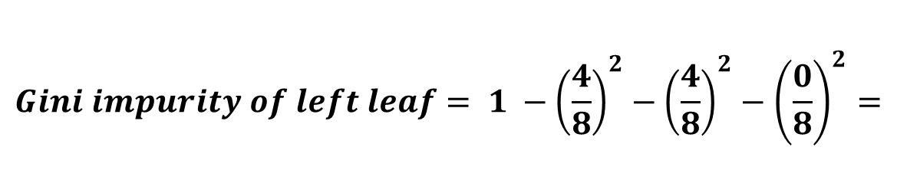
Is the color of the fruit red?
True
False
$$Gini impurity of left leaf= 1 −{\left(\frac{4}{8}\right)}^{2}−{\left(\frac{4}{8}\right)}^{2}−{\left(\frac{0}{8}\right)}^{2}=$$
$$0.5$$

Slide 29



Is the color of the fruit red?
True
False
$$Gini impurity of left leaf=$$
$$0.5$$

Slide 30



Is the color of the fruit red?
True
False
$$Gini impurity of left leaf=$$
$$0.5$$

Slide 31


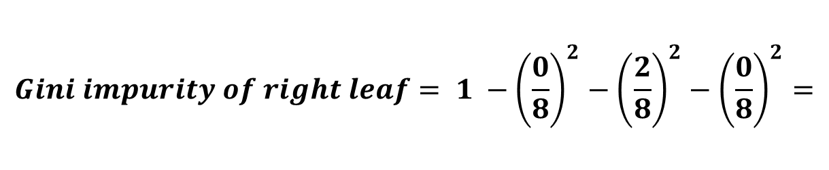

Is the color of the fruit red?
True
False
$$Gini impurity of left leaf=$$
$$0.5$$
$$Gini impurity of right leaf= 1 −{\left(\frac{0}{8}\right)}^{2}−{\left(\frac{2}{8}\right)}^{2}−{\left(\frac{0}{8}\right)}^{2}=$$
$$0.9375$$

Slide 32



Is the color of the fruit red?
True
False
$$Gini impurity of left leaf=$$
$$0.5$$
$$Gini impurity of right leaf=$$
$$0.9375$$
Let us now calculate the total gini impurity of both leaves

Slide 33
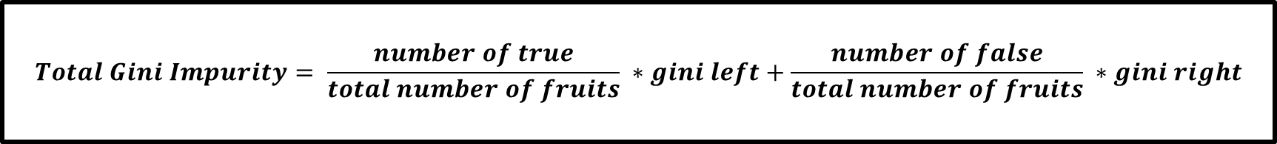
Is the color of the fruit red?
True
False
$$Gini impurity of left leaf=$$
$$0.5$$
$$Gini impurity of right leaf=$$
$$0.9375$$
$$Total Gini Impurity= \frac{number of true}{total number of fruits} ∗gini left+\frac{number of false}{total number of fruits} ∗gini right$$

Slide 34
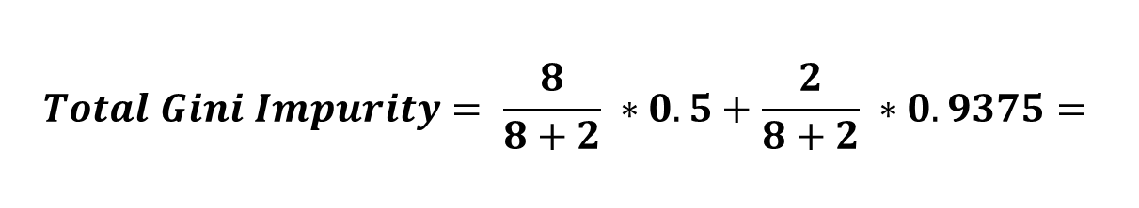

Is the color of the fruit red?
True
False
$$Gini impurity of left leaf=$$
$$0.5$$
$$Gini impurity of right leaf=$$
$$0.9375$$
$$Total Gini Impurity= \frac{8}{8+2} ∗0.5+\frac{2}{8+2} ∗0.9375=$$
$$0.5875$$

Slide 35

Is the color of the fruit red?
True
False
The Gini Impurity for “Is the color of the fruit red” is
$0.5875$

Slide 36
Is Round?
True
False
Let us now also calculate the total gini impurity of “Is Round?”

Slide 37
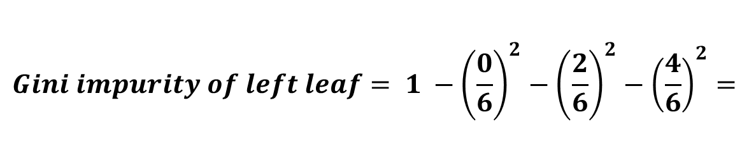

Is Round?
True
False
$$Gini impurity of left leaf= 1 −{\left(\frac{0}{6}\right)}^{2}−{\left(\frac{2}{6}\right)}^{2}−{\left(\frac{4}{6}\right)}^{2}=$$
$$0.4444$$

Slide 38

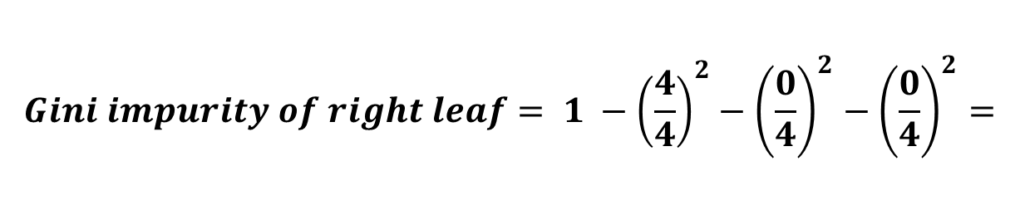
Is Round?
True
False
$$Gini impurity of right leaf= 1 −{\left(\frac{4}{4}\right)}^{2}−{\left(\frac{0}{4}\right)}^{2}−{\left(\frac{0}{4}\right)}^{2}=$$
$$0$$

Slide 39



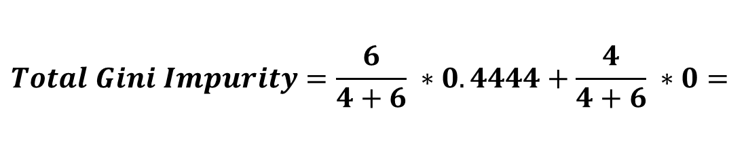


Is Round?
True
False
$$Gini impurity=$$
$$0.4444$$
$$Gini impurity=$$
$$0$$
$$Total Gini Impurity=\frac{6}{4+6} ∗0.4444+\frac{4}{4+6} ∗0=$$
$$0.26664$$

Slide 40

Is Round?
True
False
The Gini Impurity for “Is Round” is
$$0.26664$$

Slide 41




Is the color of the fruit red?
Is Round?
True
False
True
False
$$Gini Impurity =$$
$0.5875$
$$Gini Impurity =$$
$$0.26664$$

Slide 42


Is Diameter <= ?
True
False
$$Gini Impurity =$$
$$???$$
We also need to calculate the total gini impurity of “Is Diameter?”

Slide 43
Is Diameter <= ?
True
False
$$Gini Impurity =$$
$$???$$
Because this feature contains numerical values, calculating its gini will be different

Slide 44

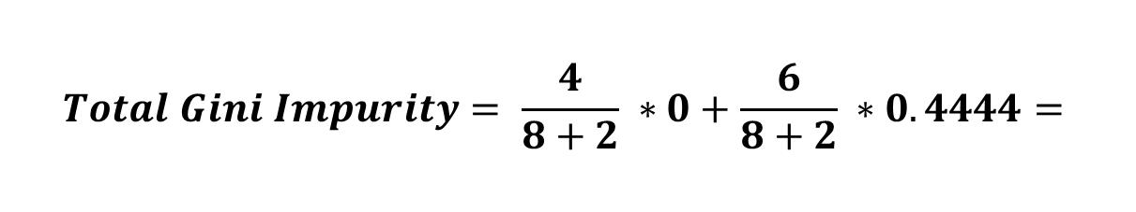





Diameter | Label
1 | Cherry
1 | Cherry
1 | Cherry
1 | Cherry
5 | Apple
6 | Orange
7 | Orange
7 | Apple
8 | Apple
9 | Apple
1.0
Diameter <= 1
1.0
1.0
True
False
3.0
5.5
6.5
7.0
$$Gini impurity=$$
$$0$$
$$Gini impurity=$$
$$0.4444$$
7.5
$$Total Gini Impurity= \frac{4}{8+2} ∗0+\frac{6}{8+2} ∗0.4444=$$
8.5
$$0.2666$$
The Gini Impurity for “Diameter <= 1” is
$$0.2666$$

Slide 45

Diameter | Label
1 | Cherry
1 | Cherry
1 | Cherry
1 | Cherry
5 | Apple
6 | Orange
7 | Orange
7 | Apple
8 | Apple
9 | Apple
1.0
Diameter <= 3
1.0
1.0
True
False
3.0
5.5
6.5
7.0
$$Gini impurity=$$
$$0$$
$$Gini impurity=$$
$$0.4444$$
7.5
8.5
The Gini Impurity for “Diameter <= 3” is
$$0.2666$$

Slide 46



Diameter | Label
1 | Cherry
1 | Cherry
1 | Cherry
1 | Cherry
5 | Apple
6 | Orange
7 | Orange
7 | Apple
8 | Apple
9 | Apple
1.0
Diameter <= 5.5
1.0
1.0
True
False
3.0
5.5
6.5
7.0
$$Gini impurity=$$
$$0.3199$$
$$Gini impurity=$$
$$0.48$$
7.5
8.5
The Gini Impurity for “Diameter <= 5.5” is
$$0.3999$$

Slide 47



Diameter | Label
1 | Cherry
1 | Cherry
1 | Cherry
1 | Cherry
5 | Apple
6 | Orange
7 | Orange
7 | Apple
8 | Apple
9 | Apple
1.0
Diameter <= 6.5
1.0
1.0
True
False
3.0
5.5
6.5
7.0
$$Gini impurity=$$
$$0.5$$
$$Gini impurity=$$
$$0.375$$
7.5
8.5
The Gini Impurity for “Diameter <= 6.5” is
$$0.45$$

Slide 48



Diameter | Label
1 | Cherry
1 | Cherry
1 | Cherry
1 | Cherry
5 | Apple
6 | Orange
7 | Orange
7 | Apple
8 | Apple
9 | Apple
1.0
Diameter <= 7.0
1.0
1.0
True
False
3.0
5.5
6.5
7.0
$$Gini impurity=$$
$$0.625$$
$$Gini impurity=$$
$$0$$
7.5
8.5
The Gini Impurity for “Diameter <= 7.0” is
$$0.5$$

Slide 49


Diameter | Label
1 | Cherry
1 | Cherry
1 | Cherry
1 | Cherry
5 | Apple
6 | Orange
7 | Orange
7 | Apple
8 | Apple
9 | Apple
1.0
Diameter <= 7.5
1.0
1.0
True
False
3.0
5.5
6.5
7.0
$$Gini impurity=$$
$$0.625$$
$$Gini impurity=$$
$$0$$
7.5
8.5
The Gini Impurity for “Diameter <= 7.5” is
$$0.5$$

Slide 50




Diameter | Label
1 | Cherry
1 | Cherry
1 | Cherry
1 | Cherry
5 | Apple
6 | Orange
7 | Orange
7 | Apple
8 | Apple
9 | Apple
1.0
Diameter <= 8.5
1.0
1.0
True
False
3.0
5.5
6.5
7.0
$$Gini impurity=$$
$$0.6419$$
$$Gini impurity=$$
$$0$$
7.5
8.5
The Gini Impurity for “Diameter <= 8.5” is
$$0.5777$$

Slide 51


Diameter <= 1
True
False
$$Gini impurity=$$
$$0.2666$$
We will select this “Diameter <=1” because it generated the lowest gini impurity

Slide 52






Is the color of the fruit red?
Is Round?
Diameter <= 1
True
False
True
False
True
False
$$Gini impurity=$$
$$0.5875$$
$$Gini impurity=$$
$$0.26664$$
$$Gini impurity=$$
$$0.2666$$
We now have the gini impurities for all of our features

Slide 53
Is the color of the fruit red?
Is Round?
Diameter <= 1
True
False
True
False
True
False
$$Gini impurity=$$
$$0.5875$$
$$Gini impurity=$$
$$0.26664$$
$$Gini impurity=$$
$$0.2666$$
Remember that we are comparing their gini impurities to decide which feature should be at the very top of our decision tree

Slide 54
?????
True
False
Remember that we are comparing their gini impurities to decide which feature should be at the very top of our decision tree

Slide 55
Is the color of the fruit red?
Is Round?
Diameter <= 1
True
False
True
False
True
False
$$Gini impurity=$$
$$0.5875$$
$$Gini impurity=$$
$$0.26664$$
$$Gini impurity=$$
$$0.2666$$
Because “Is Round” has the lowest gini impurity overall

Slide 56
Is color red? | Is Round? | Diameter | Label
Yes | Yes | 1 | Cherry
Yes | Yes | 1 | Cherry
Yes | Yes | 1 | Cherry
Yes | Yes | 1 | Cherry
Yes | No | 5 | Apple
No | Yes | 6 | Orange
No | Yes | 7 | Orange
Yes | No | 7 | Apple
Yes | No | 8 | Apple
Yes | No | 9 | Apple
Is Round?
True
False
We will put “Is Round?” on the top of our decision tree!

Slide 57
Is color red? | Is Round? | Diameter | Label
Yes | Yes | 1 | Cherry
Yes | Yes | 1 | Cherry
Yes | Yes | 1 | Cherry
Yes | Yes | 1 | Cherry
Yes | No | 5 | Apple
No | Yes | 6 | Orange
No | Yes | 7 | Orange
Yes | No | 7 | Apple
Yes | No | 8 | Apple
Yes | No | 9 | Apple
Is Round?
True
False
Now, we will put the fruits that are round on the left and not round on the right

Slide 58
Is color red? | Is Round? | Diameter | Label
Yes | Yes | 1 | Cherry
Yes | Yes | 1 | Cherry
Yes | Yes | 1 | Cherry
Yes | Yes | 1 | Cherry
Yes | No | 5 | Apple
No | Yes | 6 | Orange
No | Yes | 7 | Orange
Yes | No | 7 | Apple
Yes | No | 8 | Apple
Yes | No | 9 | Apple
Is Round?
True
False
This node is Impure, so let us see if we can reduce the impurity by splitting the fruits that is color red or by its diameter

Slide 59
Is color red? | Is Round? | Diameter | Label
Yes | Yes | 1 | Cherry
Yes | Yes | 1 | Cherry
Yes | Yes | 1 | Cherry
Yes | Yes | 1 | Cherry
Yes | No | 5 | Apple
No | Yes | 6 | Orange
No | Yes | 7 | Orange
Yes | No | 7 | Apple
Yes | No | 8 | Apple
Yes | No | 9 | Apple
Is Round?
True
False
This node is Impure, so let us see if we can reduce the impurity by splitting the fruits that is color red or by its diameter

Slide 60
Is color red? | Is Round? | Diameter | Label
Yes | Yes | 1 | Cherry
Yes | Yes | 1 | Cherry
Yes | Yes | 1 | Cherry
Yes | Yes | 1 | Cherry
Yes | No | 5 | Apple
No | Yes | 6 | Orange
No | Yes | 7 | Orange
Yes | No | 7 | Apple
Yes | No | 8 | Apple
Yes | No | 9 | Apple
Is Round?
True
False
Is color Red?
Diameter <= 1
True
False
True
False
This node is Impure, so let us see if we can reduce the impurity by splitting the fruits that is color red or by its diameter

Slide 61


Is color red? | Is Round? | Diameter | Label
Yes | Yes | 1 | Cherry
Yes | Yes | 1 | Cherry
Yes | Yes | 1 | Cherry
Yes | Yes | 1 | Cherry
Yes | No | 5 | Apple
No | Yes | 6 | Orange
No | Yes | 7 | Orange
Yes | No | 7 | Apple
Yes | No | 8 | Apple
Yes | No | 9 | Apple
Is Round?
True
False
Is color Red?
Diameter <= 1
True
False
True
False
$$Gini impurity of=$$
$$0$$
We will start asking if the 6 remaining fruits is color red

Slide 62


Is color red? | Is Round? | Diameter | Label
Yes | Yes | 1 | Cherry
Yes | Yes | 1 | Cherry
Yes | Yes | 1 | Cherry
Yes | Yes | 1 | Cherry
Yes | No | 5 | Apple
No | Yes | 6 | Orange
No | Yes | 7 | Orange
Yes | No | 7 | Apple
Yes | No | 8 | Apple
Yes | No | 9 | Apple
Is Round?
True
False
Is color Red?
Diameter <= 1
True
False
True
False
We will start asking if the 6 remaining fruits has a diameter of less than or equal to 1
$$Gini impurity of=$$
$$0$$

Slide 63


Is color red? | Is Round? | Diameter | Label
Yes | Yes | 1 | Cherry
Yes | Yes | 1 | Cherry
Yes | Yes | 1 | Cherry
Yes | Yes | 1 | Cherry
Yes | No | 5 | Apple
No | Yes | 6 | Orange
No | Yes | 7 | Orange
Yes | No | 7 | Apple
Yes | No | 8 | Apple
Yes | No | 9 | Apple
Is Round?
True
False
Is color Red?
Diameter <= 1
True
False
True
False
$$Gini impurity of=$$
$$0$$
$$Gini impurity of=$$
$$0$$
Since both have a gini impurity of zero, we can use either one.

Slide 64
Is color red? | Is Round? | Diameter | Label
Yes | Yes | 1 | Cherry
Yes | Yes | 1 | Cherry
Yes | Yes | 1 | Cherry
Yes | Yes | 1 | Cherry
Yes | No | 5 | Apple
No | Yes | 6 | Orange
No | Yes | 7 | Orange
Yes | No | 7 | Apple
Yes | No | 8 | Apple
Yes | No | 9 | Apple
Is Round?
True
False
Is color Red?
Diameter <= 1
True
False
True
False
$$Gini impurity of=$$
$$0$$
$$Gini impurity of=$$
$$0$$
Let us choose “Is color Red?”

Slide 65
Is color red? | Is Round? | Diameter | Label
Yes | Yes | 1 | Cherry
Yes | Yes | 1 | Cherry
Yes | Yes | 1 | Cherry
Yes | Yes | 1 | Cherry
Yes | No | 5 | Apple
No | Yes | 6 | Orange
No | Yes | 7 | Orange
Yes | No | 7 | Apple
Yes | No | 8 | Apple
Yes | No | 9 | Apple
Is Round?
True
False
Is color Red?
True
False
Let us choose “Is color Red?”

Slide 66
Is color red? | Is Round? | Diameter | Label
Yes | Yes | 1 | Cherry
Yes | Yes | 1 | Cherry
Yes | Yes | 1 | Cherry
Yes | Yes | 1 | Cherry
Yes | No | 5 | Apple
No | Yes | 6 | Orange
No | Yes | 7 | Orange
Yes | No | 7 | Apple
Yes | No | 8 | Apple
Yes | No | 9 | Apple
Is Round?
True
False
Is color Red?
True
False
Since there is no reason to split the leaf nodes, the output of each leaf will be our output values.

Slide 67
Is color red? | Is Round? | Diameter | Label
Yes | Yes | 1 | Cherry
Yes | Yes | 1 | Cherry
Yes | Yes | 1 | Cherry
Yes | Yes | 1 | Cherry
Yes | No | 5 | Apple
No | Yes | 6 | Orange
No | Yes | 7 | Orange
Yes | No | 7 | Apple
Yes | No | 8 | Apple
Yes | No | 9 | Apple
Is Round?
True
False
Is color Red?
True
False
We are done building our decision tree!

Slide 68
References
https://www.ibm.com/topics/decision-trees
https://www.ibm.com/docs/en/db2/11.5?topic=building-decision-trees
https://www.youtube.com/watch?v=_L39rN6gz7Y&t=676s

